Slide 1
Direct Marketing Campaign Analysis
By InternPulse Data Analyst Group 5 May 2025
Ogochukwu Nneka Uchenwoke
Nse Stephen Anyameluhor
Seunfunmi Rachel Adegboyega

Slide 2


Project Overview
Objective: Analyze customer data from direct phone campaigns promoting term deposits.
Goal: Identify patterns driving customer conversion to refine marketing strategy.

Slide 3
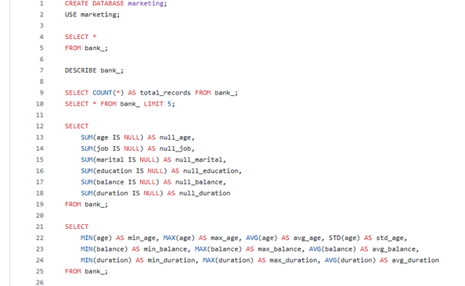
Methodology Summary
Data Prep: Cleaned and imported into MySQL → connected to Power BI.
Analysis: SQL-driven EDA + segmentation by demographics.
Visualization: Built dynamic Power BI dashboard (bar, pie, slicers, KPIs).

Slide 4
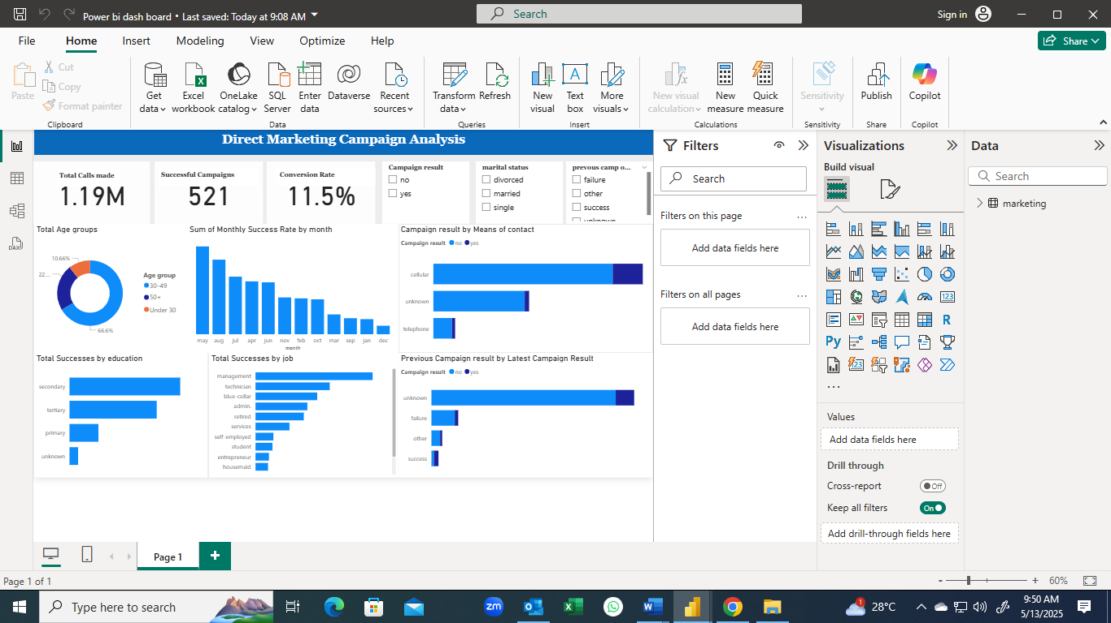

Slide 5
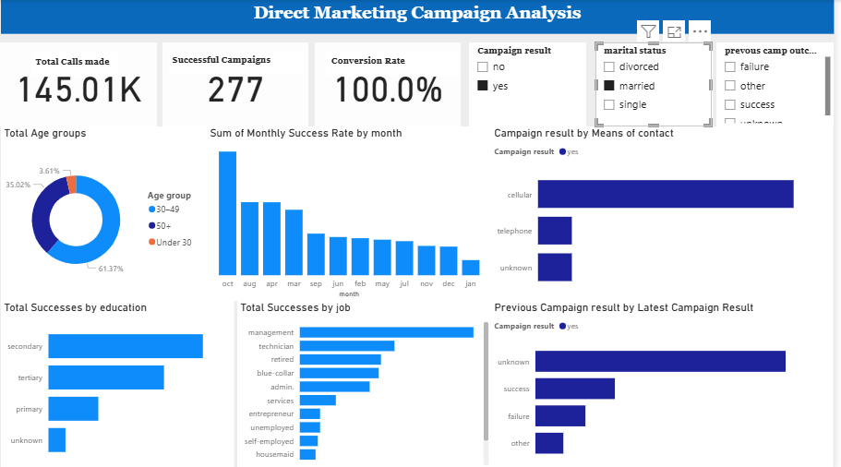

Slide 6
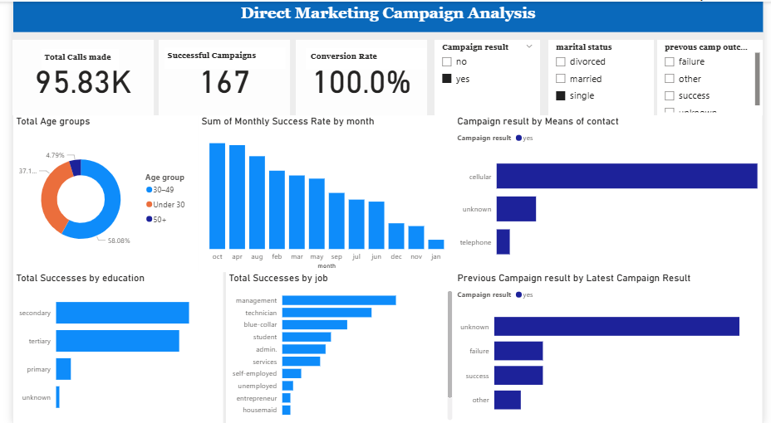

Slide 7
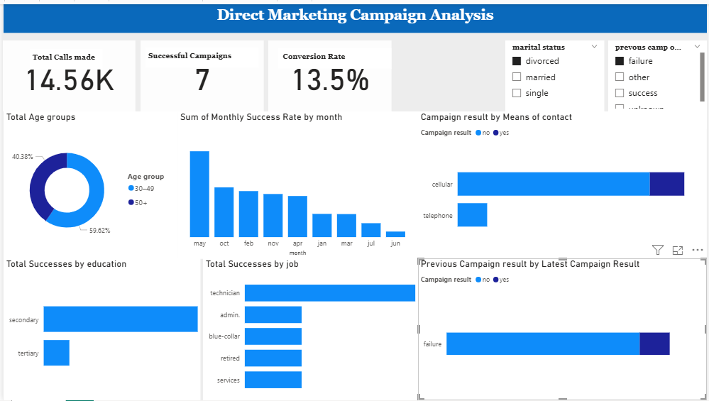

Slide 8
🎯 Campaign Key Results
11% Conversion Rate: Only 11% of contacted clients subscribed.
Age Influence: Highest success among clients aged 50+.
High-Performing Segments:
Retirees and students had the best conversion rates.
Singles and those with a university degree responded better.
Call Duration Matters: Longer phone calls linked to higher conversion likelihood.
Prior Contact Boosts Success: Clients previously contacted showed improved responsiveness.
.
.

Slide 9
Strategic Recommendations
Targeting: Prioritize clients aged 50+, retirees, students.
Call Strategy: Focus on duration, quality.
Re-engagement: Retarget previously contacted clients.
Segmentation: Custom messaging for singles, students, degree holders.
Timing Optimization: Analyze call timing patterns.

Slide 10



Thank You
Ogochukwu Nneka Uchenwoke
Nse Stephen Anyameluhor
Seunfunmi Rachel Adegboyega

